Slide 1
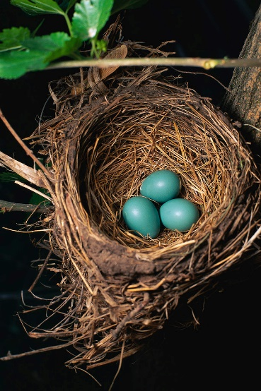
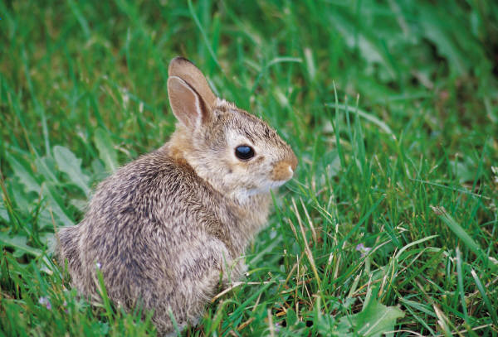
1. Question
Wild Life Habitats
Next
1
2
3
4
5
6
As more homes and businesses are built in Maryland, the natural habitat that sustains native plants, insects, birds, and small animals is disappearing. As a result, small mammals have nowhere to hide from predators. Birds are losing spaces to build their nests and many animals can not find the food they need to survive the winter.
How can we assist these animals in surviving? We can create a wild life habitat!
A wild life habitat is an environment that provides food, water, space, cover and a place to raise young for the wildlife that live in and around your school.
Image Source: Microsoft Office.
How can wild life habitats help protect a variety of local species?

Slide 2
2. Information Sources
Next
1
2
3
4
5
6
Using the resources below, learn about the environment that you could encounter around your school. Record your findings here. Use the glossary if you struggle with any of the science words.
Forest resources | Wetland resources | Other resources
What is a forest? Check out the photo gallery “Fire in the Wild” World Book Student – Forests World Book Kids – Forests | World Book Student – Wetland EPA- Wetlands World Book Kids – Wetland | Exploring Nature - Meadows Maryland Native Plants – Coastal Plain (skip to page 9 for complete list) Maryland Native Plants – Piedmont (skip to page 9 for complete list) Serpentine- Grasslands

Slide 3
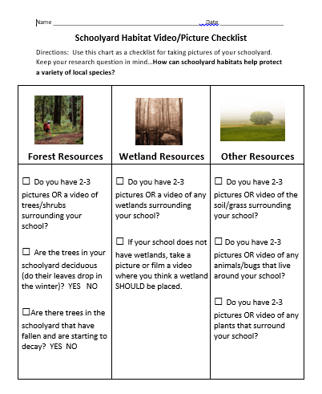
3. Student Activity
Next
1
2
3
4
5
6
It is now time to head outside the library and into your school yard!
Using a device that can take video and/or pictures, work in teams to document the habitat outside of your school.
Use this checklist to make sure that you record all of the findings that you need.
Image Source: clipart.com by subscription

Slide 4
4. Assessment Activity
Next
1
2
3
4
5
6
Now it is your turn to answer the focus question…but how?
How can schoolyard habitats help protect a variety of local species?
You will take the information that you’ve learned about habitats AND your pictures and videos from your own schoolyard to construct a public service announcement for your school.
Your PSA can be in the form of any of the following:
Morning announcements - Rubric
Video for announcements - Rubric
Our Schoolyard habitat is important!
Image Source: clipart.com by subscription
Follow the rubrics to earn an A!

Slide 5
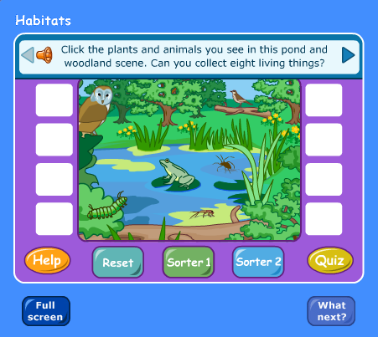
5. Enrichment Activities
Next
1
2
3
4
5
6
Habitat – Living Things Game
Image Source: GCPS Schools – Science Clips

Slide 6
6. Teacher Support Materials
1
2
3
4
5
6
Grade Level and Content Area Grade 4 – Library Media Center
Standards See attached document.
Time Frame: 2 class periods in the Library, 1 class period in the schoolyard
Differentiation strategies for this lesson:
audio read-aloud, labeled reading levels/Lexiles, and embedded dictionaries.
Learning Styles addressed in this lesson:
Visual, Auditory, Kinesthetic, Active, Reflective, Global Understanding
Notes to the teacher:
Collaborate with your 4th grade classroom teacher to implement this lesson.
To implement a schoolyard habitat, refer to this guide from the National Wildlife Foundation.
On Slide 2, the sources marked with a are more challenging resources.
On Slide 2, in the column titled “Other Resources”, you can eliminate one of the Maryland Native Plants – Coastal Plain or Piedmont resources depending upon your location in Baltimore County. See this map for your location.
Last updated: April 2015
Modified, reproduced and published with permission from BPCS-ODL. The models can be used non-profit, educational use only.

