Slide 1
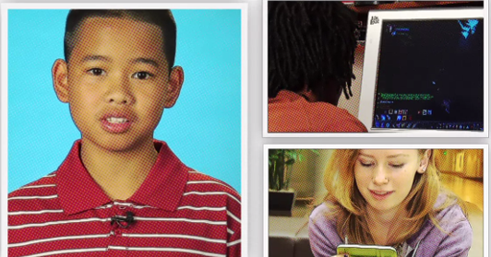
1. Question
Online Safety & Password Security
Next
1
2
3
4
5
6
We use digital resources in school and at home. It’s important that we know how to keep ourselves safe online, including keeping our passwords secure.
Before watching the video to the right, discuss how you think you can stay safe online in a digital world.
After you’ve watched the video think about this:
What are some things that you can do to protect yourself online?
Click on the picture below to watch a video about being safer online.
Image Source: commonsensemedia.org.
How do you stay safe and create secure passwords when you go online?

Slide 2
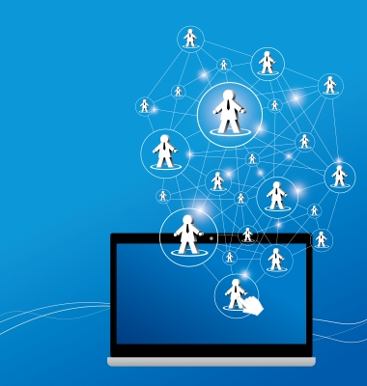
2. Information Sources
Next
1
2
3
4
5
6
There are 4 resources below to help you learn more about online safety and password security. There are articles and video resources, so be sure to have your headphones ready!
Internet Safety
Strong Passwords
The Password Rap
Safe Cyberspace Surfing
= Article resource = Video resource
Image Source: freedigitalphotos.net

Slide 3
3. Student Activity
Next
1
2
3
4
5
6
Your first step is to examine the resources on Slide 2. While you are exploring, look for information about how to create and maintain a secure password. Also look for tips and rules regarding how to be safe when you go online.
This graphic organizer will help you to organize your thoughts about passwords and online safety. Remember, since you are taking notes, complete sentences are not necessary.
Image Source: freedigitalphotos.net

Slide 4
4. Assessment Activity
Next
1
2
3
4
5
6
You may choose to work by yourself or with a partner for the Assessment Activity. You will design a cartoon that demonstrates safe online behavior and password security.
Here is the rubric that your teacher will use to grade your cartoon.
You will use the cartoon creator from the Read-Write-Think website in order to complete your assessment activity.
Image Source: freedigitalphotos.net

Slide 5
5. Enrichment Activities
Next
1
2
3
4
5
6
Explore the DinoPass website to see how you can have passwords created just for you! Remember to examine both the simple and strong passwords. Evaluate the passwords that are created. Do they meet the rules you learned from our research?
Image Source: freedigitalphotos.net

Slide 6
6. Teacher Support Materials
1
2
3
4
5
6
Grade Five, Digital Citizenship
Common Core State Standards
Reading: 1. Read closely to determine what the text says explicitly and to make logical inferences from it; cite specific textual evidence when writing or speaking to support conclusions drawn from the text.
Writing: 7. Conduct short as well as more sustained research projects based on focused questions, demonstrating understanding of the subject under investigation.
Standards for the 21st Century Learner 1.1.6 Read, view, and listen for information presented in any format (e.g. textual, visual, media, digital) in order to make inferences and gather meaning. 2.1.3 Use strategies to draw conclusions from information and apply knowledge to curricular areas, real-world situations, and further investigations.
ISTE NETS - National Educational Technology Standards for Students
3. Research and Information Fluency: Students apply digital tools to gather, evaluate, and use information. b. Locate, organize, analyze, evaluate, synthesize, and ethically use information from a variety of sources and media.
4. Critical Thinking, Problem Solving, and Decision Making: Students use critical thinking skills to plan and conduct research, manage projects, solve problems, and make informed decisions using appropriate digital tools and resources. c. Collect and analyze data to identify solutions and/or make informed decisions.
Time Frame: 1-2 50 minute class periods
Differentiation strategies for this lesson:
The Slam Dunk can be completed individually, with a partner, or in small groups.
Learning Styles addressed in this lesson:
Visual, Auditory, Tactile
Notes to the teacher:
Collaborate with your school library media specialist to implement this lesson.
Last updated April 2015
Modified, reproduced, and published with permission from GCPS-ODL. The models can be used for non-profit, educational school use only.

