Slide 1
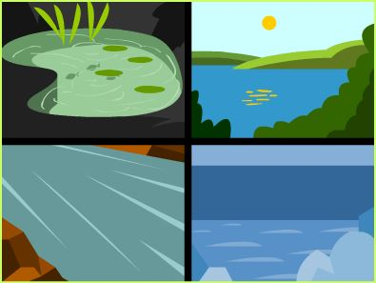
1. Question
Maryland Ecosystems
Next
1
2
3
4
5
6
An ecosystem is a complex set of relationships among living and non-living things. The living, once living, and non-living factors of an area interact with each other in an ecosystem.
Habitats are the place where a plant or animal lives which provides the resources for energy (food), water, and space.
What is the food chain and what happens when an organism is removed from the food chain?
What are the roles of producers, consumers, and decomposers in a food chain?
What happens when there is competition for space, food, and water?
Ecosystems
How do individuals and groups of organisms interact with each other and their environment?

Slide 2
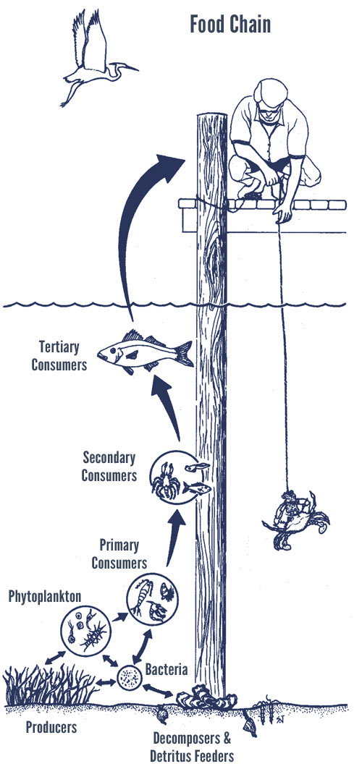
2. Information Sources
Next
1
2
3
4
5
6
These resources below will help you examine the essential question “How do individuals and groups of organisms interact with each other and their environment? ”
Digital resources about Maryland habitats and ecosystems:
Marshes & Wetlands: Information from the Chesapeake Bay Foundation
Marshes, Swamps, & Bogs: Exploring Nature
Shoreline (Beaches and Tidal Flats): Information from the Chesapeake Bay Foundation
Intertidal Zones: Exploring Nature
Forests: Information from the Chesapeake Bay Foundation
Deciduous Forests: Exploring Nature
Meadows: Exploring Nature
Serpentine Grassland: MD Department of Natural Resources
Videos: https://www.youtube.com/watch?v=SWvtRf4TAO4 (Courtesy of makemegenius.com) Biomes:http://www.watchknowlearn.org/Video.aspx?VideoID=6663(Courtesy of WatchKnowLearn.org) | Databases: Worldbook Student
Image Source:
Chesapeake Bay Foundation

Slide 3
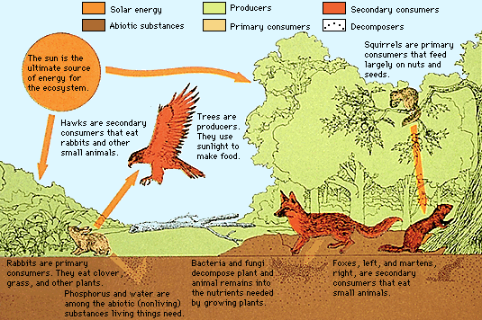
3. Student Activity
Next
1
2
3
4
5
6
Use the resources to research one of the Chesapeake Bay’s 4 ecosystems as assigned by your teacher.
Use the note sheets linked below to record your research:
Shoreline
Wetland
Forest
Meadow
Image Source: Worldbook

Slide 4
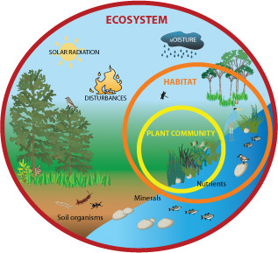
4. Assessment Activity
Next
1
2
3
4
5
6
Use the research you have compiled on your note sheets to create an informative pamphlet that could accompany the Eco-chamber you create in the EcoTrekkers Unit.
Microsoft Publisher is available on your GCPS computer desktop.
Microsoft Publisher Instructions.
Or you could create a Multimedia Presentation to share with your fellow classmates.
Multimedia Presentation Ideas:
Microsoft Powerpoint (Rubric)
Prezi (Rubric)
Image Source: Montana Science Partnership

Slide 5
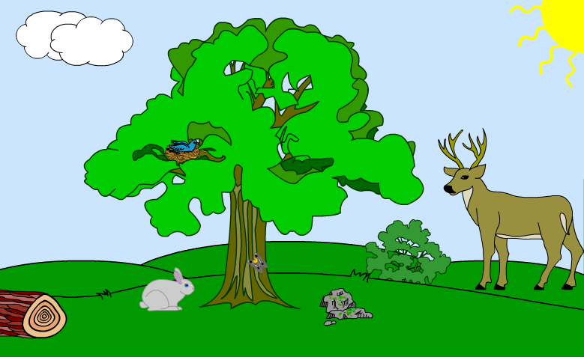
5. Enrichment Activities
Next
1
2
3
4
5
6
Create a Wildflower Meadow: Information about meadows and instructions on how to grow one in your backyard (Courtesy of kidsgardening.org))
Ecosystem Study Jam: From Scholastic, a video about ecosystems with a follow up quiz.
Select the image above to analyze an ecosystem
Image Source: PBS Learning Media

Slide 6
6. Teacher Support Materials
1
2
3
4
5
6
Grade Level and Content Area: Science, Grade 5
Maryland State Curriculum
Maryland State Curriculum—Science, 3.0 Life Science , E.1, F.1, Writing 4.0 A. 7.c
Common Core State Standards
Reading: 1. Read closely to determine what the text says explicitly and to make logical inferences from it; cite specific textual evidence when writing or speaking to support conclusions drawn from the text.
Writing: 7. Conduct short as well as more sustained research projects based on focused questions, demonstrating understanding of the subject under investigation.
Standards for the 21st Century Learner 1.1.6 Read, view, and listen for information presented in any format (e.g. textual, visual, media, digital) in order to make inferences and gather meaning. 2.1.3 Use strategies to draw conclusions from information and apply knowledge to curricular areas, real-world situations, and further investigations.
ISTE Standards
2. Communication and collaboration: Students use digital media and environments to communicate and work collaboratively, including at a distance, to support individual learning and contribute to the learning of others. b. Communicate information and ideas effectively to multiple audiences using a variety of media and formats.
3. Research and Information Fluency: Students apply digital tools to gather, evaluate, and use information. b. Locate, organize, analyze, evaluate, synthesize, and ethically use information from a variety of sources and media.
4. Critical Thinking, Problem Solving, and Decision Making: Students use critical thinking skills to plan and conduct research, manage projects, solve problems, and make informed decisions using appropriate digital tools and resources. c. Collect and analyze data to identify solutions and/or make informed decisions.
Time Frame: 1-3 lessons
Differentiation strategies for this lesson:
Direct students to use learning tools included in our GCPS-licensed databases, such as: audio read-aloud, labeled reading levels/Lexiles, and embedded dictionaries.
Learning Styles addressed in this lesson: Visual, Auditory, Reflective, Global, Analytical
Notes to the teacher:
Collaborate with your school library media specialist to implement this lesson. If you plan to use one of the multimedia presentation tools in slide 4 and are unsure on how to teach or implement this tool, your library media specialist can assist.
Silver Stars: I can read this on my own
Gold Stars: Challenge Me!
Last updated: April 2015
Modified, reproduced and published with permission from BPCS-ODL. The models can be used non-profit, educational use only.

