Slide 1
1. Question
American Symbols
Next
1
2
3
4
5
6
Have you ever looked closely at the back of a dollar bill?
Do you know what the symbols are called? Why are these symbols there? American symbols can be found all around you. Can you name those symbols? What do they represent?
Video Source: Discovery Education by subscription.
How do the symbols representing America contribute to patriotism?

Slide 2
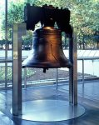
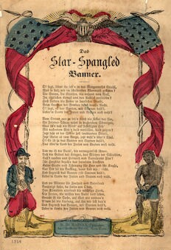
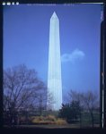
2. Information Sources
Next
1
2
3
4
5
6
Discover the meaning behind these U.S. Symbols.
Liberty Bell | U.S. Flag | Statue of Liberty
Great Seal | Washington Monument | Star Spangled Banner

Slide 3
3. Student Activity
Next
1
2
3
4
5
6
Using the American Symbols and Monuments Note Taker, identify the symbol and monument, explain what it stands for, and draw what it looks like.
You need to choose 4 symbols or monuments and complete the organizer.
Source: Cassie Smith from Teachers Pay Teachers

Slide 4
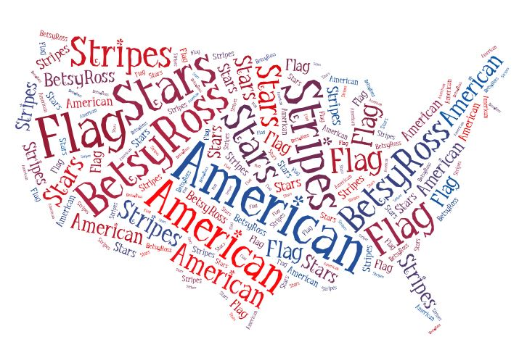
4. Assessment Activity
Next
1
2
3
4
5
6
After you have research four American Symbols, choose one symbol or monument that interested you the most.
Then complete this organizer which will help you complete your final assessment.
You can choose any of the three tools to create it. Use this checklist to help you!
Create using PowerPoint.
Create using Taxgedo.
Create using the Printing Press.
Image Source: Microsoft Office
Image Source: readwritethink.org

Slide 5
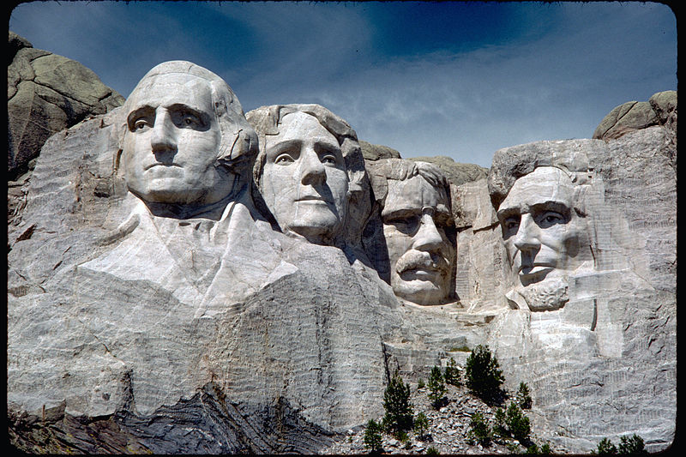
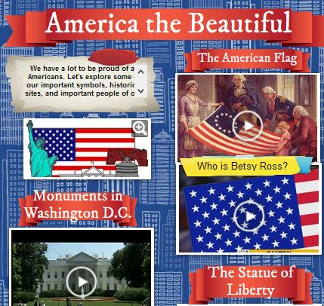
5. Enrichment Activities
Next
1
2
3
4
5
6
Learn more about
American symbols with this interactive poster.
Can you guess the American symbol? Click the speaker to try it out.
Audio Source: Discovery Education by subscription
Image Source: Discovery Education by subscription

Slide 6
6. Teacher Support Materials
1
2
3
4
5
6
Grade Level and Content Area
Maryland State Curriculum Grade 2: Library Media Curriculum
Common Core State Standards
RI.2.1. Read closely to determine what the text says explicitly and to make logical inferences from it; cite specific textual evidence when writing or speaking to support conclusions drawn from the text.
RI.2.2. Determine central ideas or themes of a text and analyze their development; summarize the key supporting details and ideas.
SL.2.1. Participate in collaborative conversations with diverse partners about grade 2 topics and texts with peers and adults in small and larger groups.
Writing: 7. Conduct short as well as more sustained research projects based on focused questions, demonstrating understanding of the subject under investigation.
Maryland State Standards Social Studies:
Standard 1.0- Political Science :Topic A. The foundations and function of the government: 2. Explain how democratic skills and attitude are associated with being responsible: b. Connect certain people, symbols, songs and poems to the ideals they represent, such as George Washington portrays leadership, the American flag represents loyalty and respect, and the Star Spangled Banner represents courage and freedom.
Standards for the 21st Century Learner 1.1.6 Read, view, and listen for information presented in any format (e.g. textual, visual, media, digital) in order to make inferences and gather meaning. 2.1.3 Use strategies to draw conclusions from information and apply knowledge to curricular areas, real-world situations, and further investigations.
ISTE NETS - National Educational Technology Standards for Students
3. Research and Information Fluency: Students apply digital tools to gather, evaluate, and use information. b. Locate, organize, analyze, evaluate, synthesize, and ethically use information from a variety of sources and media.
4. Critical Thinking, Problem Solving, and Decision Making: Students use critical thinking skills to plan and conduct research, manage projects, solve problems, and make informed decisions using appropriate digital tools and resources. c. Collect and analyze data to identify solutions and/or make informed decisions.
Time Frame: Three 50 minute lessons
Differentiation strategies for this lesson:
Certain resources can have the text read to students.
Students can work in groups for this lesson.
Learning Styles addressed in this lesson:
Auditory, Visual, Kinesthetic, Reflective, Sequential, Field Independent
Notes to the teacher:
Only to be used in the Library Media curriculum.
Log in to Discovery Education may be necessary.
Students will need headphones to view resources.
LMS will need to print and make copies of organizers for students to use.
Students may need to log in to TumbleBooks and search for the story.

