Slide 1
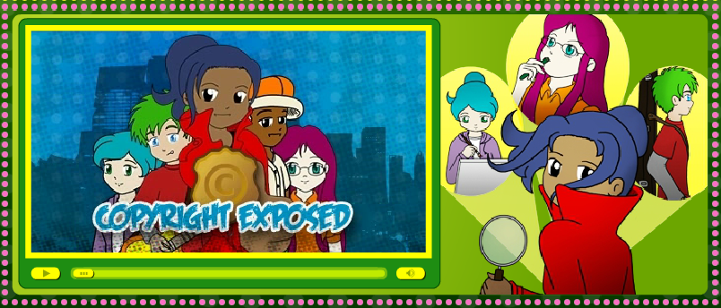
1. Question
Creative Credit and Citing Sources
Next
1
2
3
4
5
6
Have you ever created something like a story, song, or picture? How would you feel if someone took your hard work and said it was theirs?
It’s important to understand copyright laws, plagiarism, how to cite your sources, and Creative Commons licensing, so that you know how to protect your own work and respect the hard work of others!
Image Source: Library of Congress
How can I respect the rights of content creators and protect my own creative works?

Slide 2
2. Information Sources
Next
1
2
3
4
5
6
Look at the resources below to gain a better understanding of plagiarism, copyright laws, citing your sources, and creative commons.
Copyright
Common Copyright Questions
Copyright Kids
Copyright with Cyberbee
Plagiarism
KidsHealth
Creative Commons
Creative Commons Slide Show
Citing your Sources
EasyBib online citation/bibliography creator
Image source: www.clipartbest.com

Slide 3
3. Student Activity
Next
1
2
3
4
5
6
You will use information gathered from the resources on Slide 2 in order to create a presentation for 3rd or 4th graders about plagiarism and copyright laws.
For this task, you may work with 1 or 2 other students. You will need to:
1. Define plagiarism and copyright.
2. Give examples and/or laws related to these topics.
3. Explain how these topics could affect students.
4. Use Easy Bib to create citations for sources you use in your own work. Refer to EasyBib Citation Guides as needed.
5. Use Creative Commons to license and share your own creative works.
Use this organizer to collect the information you need before beginning your project.
Image Source: Vertical Measures

Slide 4
4. Assessment Activity
Next
1
2
3
4
5
6
You will use the information from slide 2 and your organizer from slide 3 to create an informative presentation about plagiarism and copyright that could be used to teach 3rd or 4th grade students.
You may use a tool of you choice to create your presentation (PowerPoint, Wixie, Prezi, etc.), as approved by your Librarian.
Use the attached scoring tool to help guide you in creating your presentation.
Image Source: keepcalm-o-matic

Slide 5
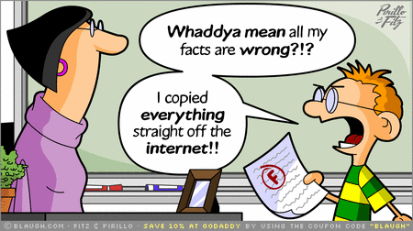
5. Enrichment Activities
Next
1
2
3
4
5
6
Check out these additional websites about copyright, plagiarism, and internet safety.
A Fair(y) Use Tale (video)
What’s a copyright? (video)
Webonauts
Cyber Café (go to the cyber café or play the games on the left hand side)
Image Source: www.plagiarismchecker.net

Slide 6
6. Teacher Support Materials
1
2
3
4
5
6
Grade Level: 5th
Content Area: Library Media
Common Core State Standards
Reading: 1. Read closely to determine what the text says explicitly and to make logical inferences from it; cite specific textual evidence when writing or speaking to support conclusions drawn from the text.
Writing: 7. Conduct short as well as more sustained research projects based on focused questions, demonstrating understanding of the subject under investigation.
Standards for the 21st Century Learner 1.1.6 Read, view, and listen for information presented in any format (e.g. textual, visual, media, digital) in order to make inferences and gather meaning. 2.1.3 Use strategies to draw conclusions from information and apply knowledge to curricular areas, real-world situations, and further investigations.
ISTE NETS - National Educational Technology Standards for Students
3. Research and Information Fluency: Students apply digital tools to gather, evaluate, and use information. b. Locate, organize, analyze, evaluate, synthesize, and ethically use information from a variety of sources and media.
4. Critical Thinking, Problem Solving, and Decision Making: Students use critical thinking skills to plan and conduct research, manage projects, solve problems, and make informed decisions using appropriate digital tools and resources. c. Collect and analyze data to identify solutions and/or make informed decisions.
Time Frame: 2 lessons (50 minutes each)
Differentiation strategies for this lesson:
Direct students to use learning tools included in our GCPS-licensed databases, such as: audio read-aloud, labeled reading levels/Lexiles, and embedded dictionaries.
Group/partner work
Learning Styles addressed in this lesson:
Visual (silent reading of websites)
Auditory (many websites have sound/read aloud features)
Kinesthetic (creation of the presentation)
Active (teamwork)
Global understanding (determining how it’s important in their life)
Notes to the teacher:
This lesson could be taught be the classroom teacher or the library media specialist, or as a collaboration among the two.
This lesson should be taught prior to any large scale research project in order to reinforce the plagiarism and copyright rules.
Last updated April 2015
Modified, reproduced, and published with permission from BCPS ODL. The models can be used for non-profit, educational school use only.

