Slide 1
1. Question
Desperately Seeking Symmetry
Next
1
2
3
4
5
6
Geometry is all around us. It is not only in objects but can also be found in written text. Print your name in capital letters on a piece of paper.
Do you see any letters that are symmetrical?
Look at the capital letters of the
alphabet to identify which ones are symmetrical.
1. Let’s graph our results.
Image Source: www.wordle.com
Where do we find symmetry in our everyday life?

Slide 2
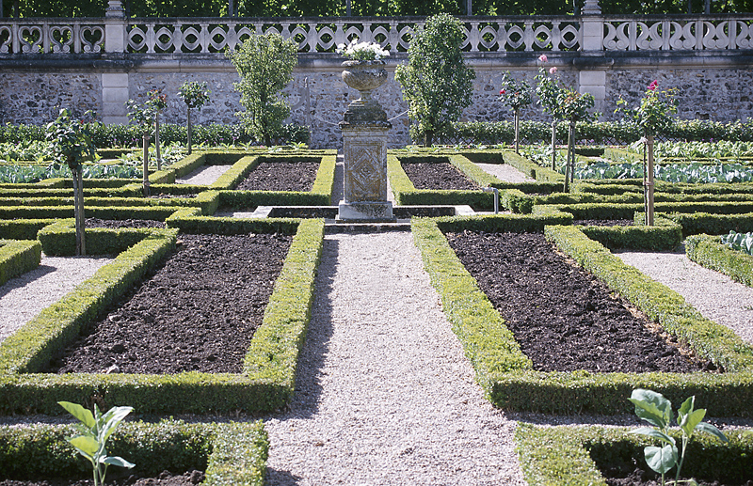
2. Information Sources
Next
1
2
3
4
5
6
First let’s watch a video on Symmetry (Safari Video).
Next we will make sure we understand symmetry with an interactive demonstration online. (There is an alternative version that does not require an internet connection. It requires ActiveInspire)
Finally, let’s practice working with symmetry.
Be a Symmetry Artist
Image Source: www.clipart.com

Slide 3
3. Student Activity
Next
1
2
3
4
5
6
Geometry is all around us. Take a minute and look around to find different shapes that you see in your room. Look for things that are symmetrical. Raise your hand when you have found five objects that show symmetry.
Now that you have a better understanding of symmetry, let’s go on a symmetry hunt. As we tour the school, use a Flipcam or another camera to take pictures of objects that have symmetry.
Take a picture of one human-made object with symmetry and one natural object of symmetry.
Your teacher may direct you to draw the items if no cameras are available.
Image Source: www.clipart.com

Slide 4
4. Assessment Activity
Next
1
2
3
4
5
6
After taking pictures from your walk around the school, you will display the pictures on the interactive white board or use the template to show the line of the symmetry to the rest of your learning community.
Oral Presentation: Share your photos and your findings about symmetry to your class. Read the rubric to prepare to give your best oral presentation.
Image Source: www.clipart.com

Slide 5
5. Enrichment Activities
Next
1
2
3
4
5
6
Here are additional websites that can be used for further exploration.
Symmetry Artist
Math Wire Patterns
Mrs. Warner’s Symmetry
IXL Math Practice
Image Source: Clipart.com with subscription

Slide 6
6. Teacher Support Materials
1
2
3
4
5
6
Maryland State Curriculum
Students will apply information in critical thinking and problem solving. Students will apply an information problem solving process model to structure effective research.
Math: The students will analyze geometric figures and pictures Topic E. Transformations Indicator 2. Analyze geometric figures and pictures Objectives a. Recognize that basic shapes have several lines of symmetry. b. Demonstrate symmetry in basic shapes and pictures by drawing 2 lines of symmetry. Common Core State Standards
Reading: 1. Read closely to determine what the text says explicitly and to make logical inferences from it; cite specific textual evidence when writing or speaking to support conclusions drawn from the text.
Standards for the 21st Century Learner 1.1.6 Read, view, and listen for information presented in any format (e.g. textual, visual, media, digital) in order to make inferences and gather meaning. 2.1.3 Use strategies to draw conclusions from information and apply knowledge to curricular areas, real-world situations, and further investigations.
Maryland Technology Literacy Standards for Students
3.0: Use a variety of technologies for learning and collaboration.
Time Frame: 2 Class periods
Differentiation:
Direct students to use comprehension tools included in databases, such as: audio read-aloud, labeled reading levels, and embedded dictionaries.
Learning Styles: Visual, Auditory, Kinesthetic
Notes to the teacher:
Flipchart was modified from the original that was found on Promethean Planet.
Background knowledge for teachers.
Alternative assignment if cameras aren’t available.
If students are debating symmetry of letters, you can demonstrate using this website.
Last updated: April 2015
Modified, reproduced and published with permission from BPCS-ODL. The models can be used non-profit, educational use only.

