Slide 1
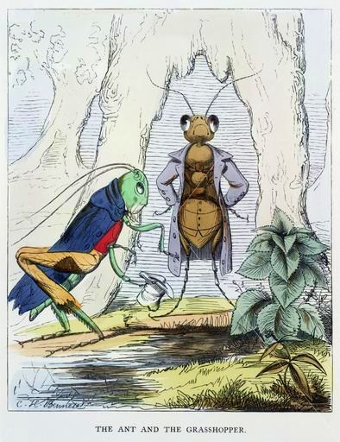
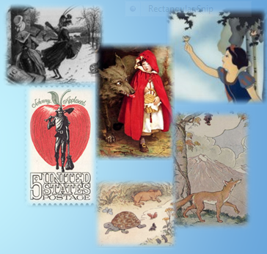
1. Question
Next
A Tale To Be Told
1
2
3
4
5
6
A folktale is a story, passed down verbally from generation to generation. Every storyteller changes the story to appeal to the audience. As time moves forward, storytellers continue to make the tale more interesting and fascinating for listeners by adding different details for the time.
Watch this video about folktales. What folktales have you read?
Image Sources: Wikimedia and Library of Congress
How are folktales different from other stories?

Slide 2
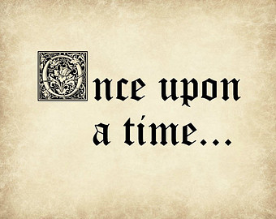
2. Information Sources
Next
1
2
3
4
5
6
You will use these resources to become a
Folktale Expert:
Introduction:
Fairy Tales, Folktales, Fables, Legends and Myths
Myths
Fairy Tales Animated Fairy Tales
Fables Aesop’s Fables Animated Fables
Legends

Slide 3
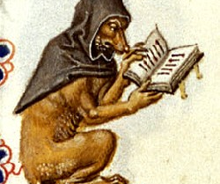
3. Student Activity
Next
1
2
3
4
5
6
There are different kinds of folktales. Each kind has a specific purpose, but they are all told to entertain and tell us something about a particular culture. Some different types of folktales are Fairy tales, Myths, Legends, Tall Tales, Fables, Trickster Tales, and Pourquoi Tales.
Your teacher will assign you to a group and ask you to become an expert on one kind of folktale.
You will go to Slide 2 and use the resources to identify elements of the folktale.
Use the inquiry organizer to take notes.
How are folktales different from other stories?

Slide 4
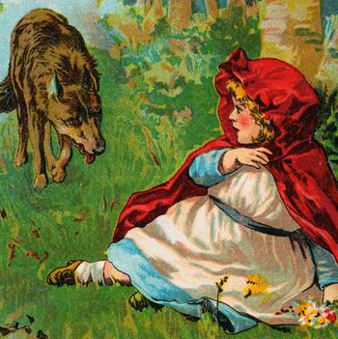
4. Assessment Activity
Next
1
2
3
4
5
6
You and your group will use Wixie or PowerPoint to create a presentation page to share your information with the rest of the class.
Your teacher will use this scoring tool to assess your flipchart page.
Image Source: www.arttoday.com by subscription

Slide 5
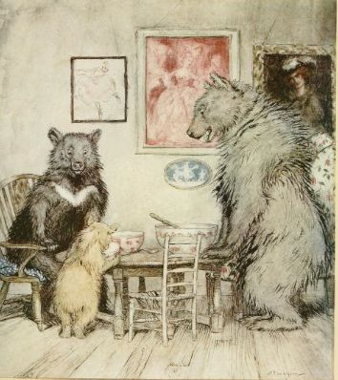
5. Enrichment Activities
Next
1
2
3
4
5
6
Read, listen to and view more Fairy Tales.
Become a Folktale Fanatic.
Write a folktale so that future generations can learn about your culture. The folktale should include details and a lesson that tells about a particular culture.
Share your folktale with younger students so that you can help the pass the oral tradition of storytelling on to future generations. You can use a digital camera or VoiceThread to record your original folktale.

Slide 6
6. Teacher Support Materials
1
2
3
4
5
6
Common Core State Standards
Reading: RL.3.2. Recount stories, including fables, folktales, and myths from diverse cultures; determine the central message, lesson, or moral and explain how it is conveyed through key details in the text.
Writing: 7. Conduct short as well as more sustained research projects based on focused questions, demonstrating understanding of the subject under investigation.
Standards for the 21st Century Learner 1.1.6 Read, view, and listen for information presented in any format (e.g. textual, visual, media, digital) in order to make inferences and gather meaning. 2.1.3 Use strategies to draw conclusions from information and apply knowledge to curricular areas, real-world situations, and further investigations.
Maryland Technology Literacy Standards for Students
3.0: Use a variety of technologies for learning and collaboration.
Time Frame:
1- 50 minute class periods.
Differentiation:
Direct students to use comprehension tools included in databases, such as: audio read-aloud, labeled reading levels, and embedded dictionaries.
Students can work individually or in groups to complete research.
Learning Styles:
Auditory, Visual, Reflective, Sequential, Field Independent, Global
Notes to the teacher:
Designed for individual research instruction.
An interactive flipchart is included to reinforce and extend the study of folktales.
Extend this research activity by having students create an original folktale and share with younger students.
Inquiry Organizer can be printed and copied for students.
Create a display of Folktale books for students to check out.
Last updated: April 2015
The models may be used for educational, non-profit school use only. This model was adapted with permission from BCPS-ODL. All other uses, transmissions, and duplications are prohibited unless permission is granted expressly. This lesson is based on Jamie McKenzie’s Slam Dunk Lesson module.

